Slide 1
Kinematics and Dynamics of Robots
Spring Semester 2021
Lecturer: Yoav Golan

Slide 2
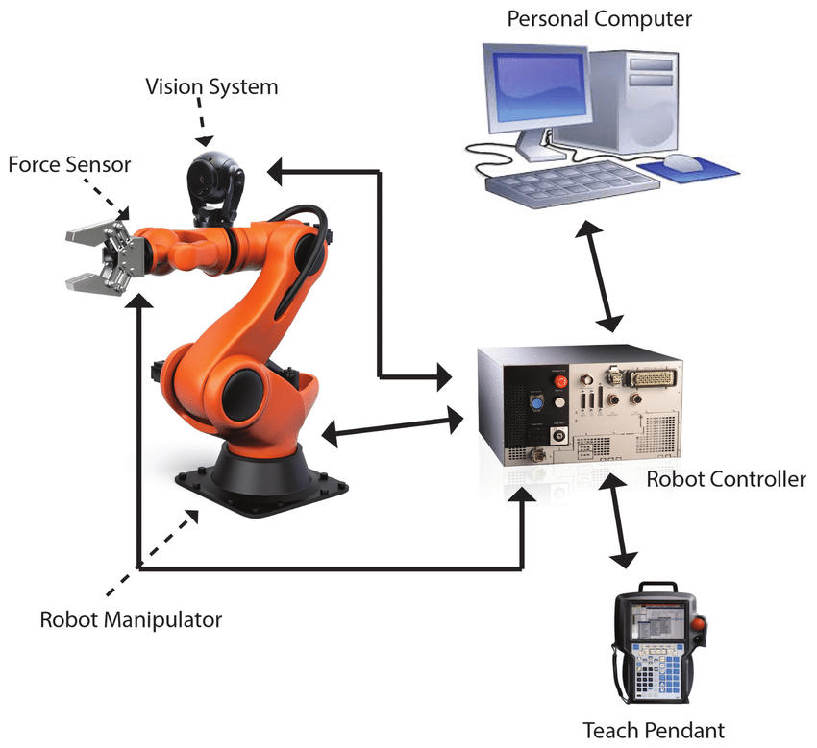
Industrial Robotic Arms

Slide 3
Robotic Simulators
There are many robot arm companies
Each company makes their own software
Rare to find more than one brand in the same factory

Slide 4
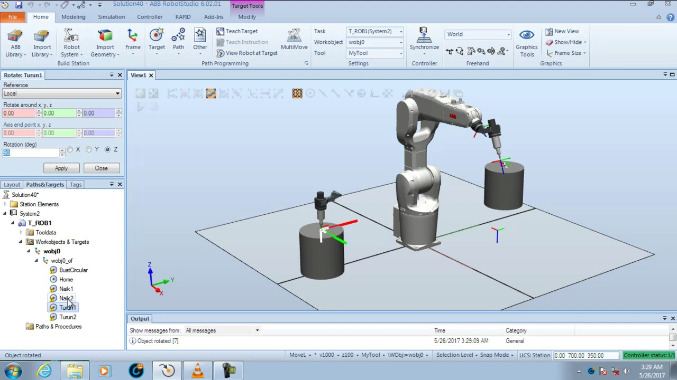
Robotic Simulators
Example: ABB. Software: RobotStudio

Slide 5
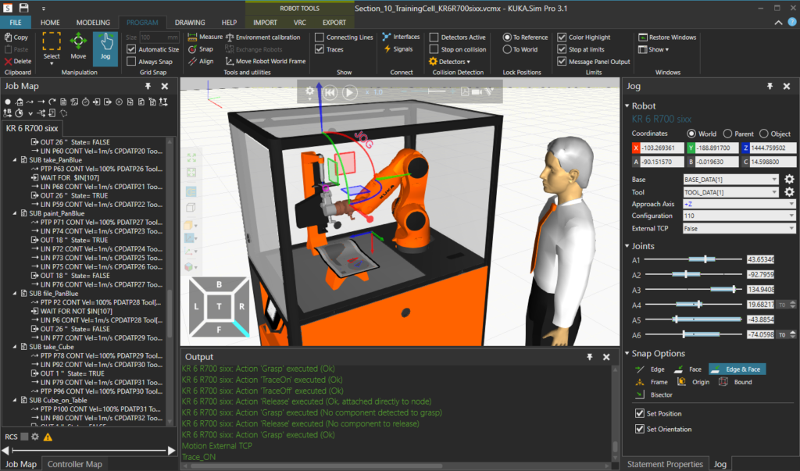
Robotic Simulators
Example: KUKA. Software: Kuka.Sim

Slide 6
Robotic Simulators
Robot simulation software allows easy, visual programming
Full integration with controller and arm
Offline/online programming

Slide 7
Robotic Simulators Typical Commands
Jog move
Joint move
Linear move
Change velocities/accelerations
Follow path
Read input
Execute output
Perform logical operations

Slide 8
Robotic Simulators Advanced Capabilities
Camera (computer vision)
Path planning
Multiple robot interaction
Physical simulation
Dynamic simulation

Slide 9
Robotic Simulators
Each company has their own:
Robots
Controllers
Simulator
Programming language
Why?

Slide 10
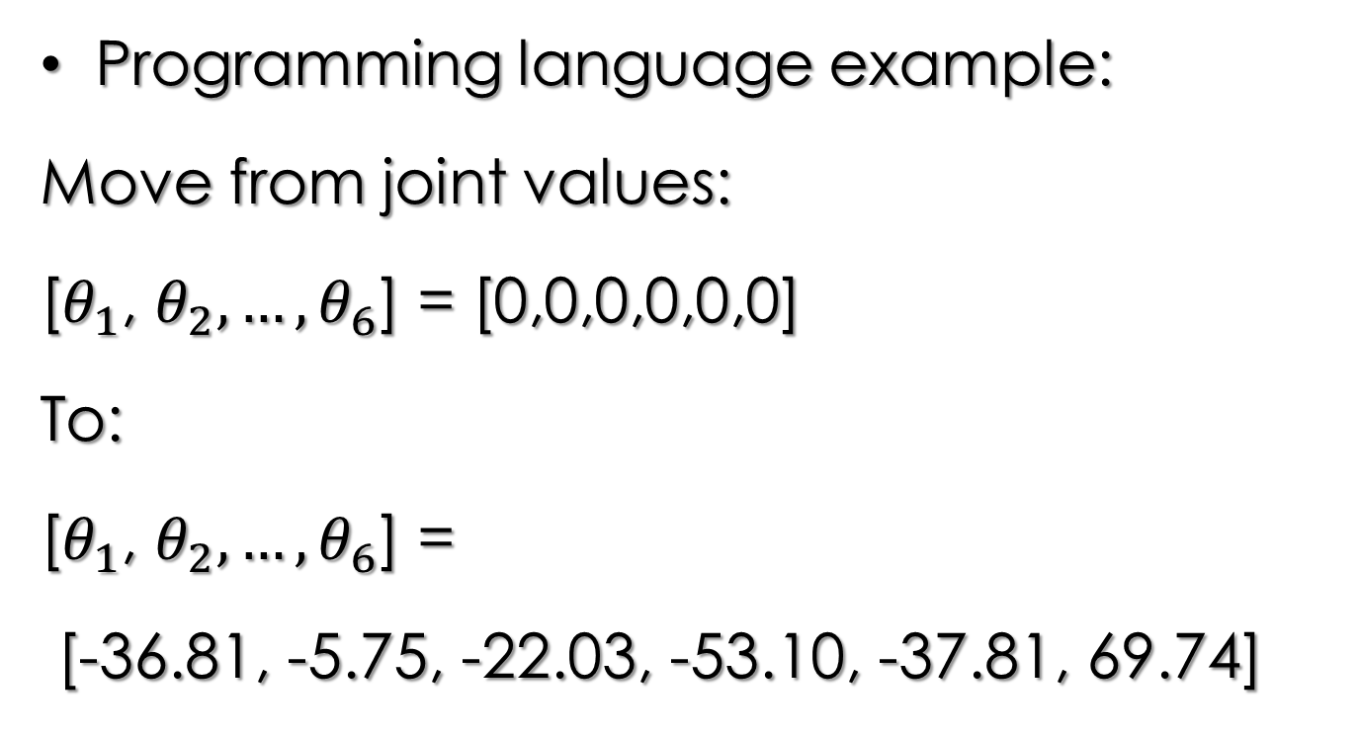
Robotic Simulators
Programming language example:
Move from joint values:
[$θ_{1}$, $θ_{2},…,θ_{6}$] = [0,0,0,0,0,0]
To:
[$θ_{1}$, $θ_{2},…,θ_{6}$] =
[-36.81, -5.75, -22.03, -53.10, -37.81, 69.74]

Slide 11
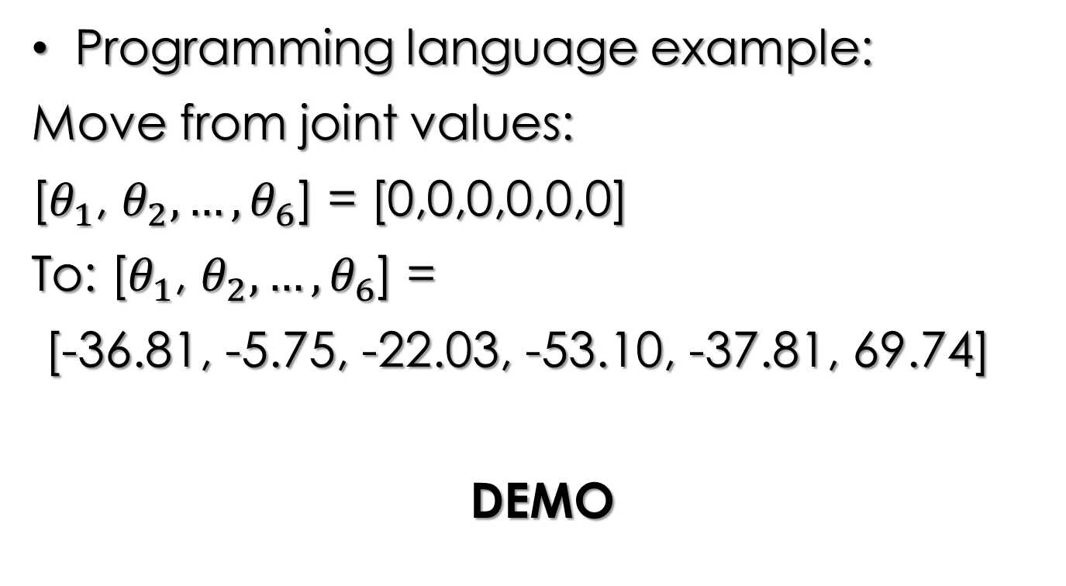
Robotic Simulators
Programming language example:
Move from joint values:
[$θ_{1}$, $θ_{2},…,θ_{6}$] = [0,0,0,0,0,0]
To: [$θ_{1}$, $θ_{2},…,θ_{6}$] =
[-36.81, -5.75, -22.03, -53.10, -37.81, 69.74]
DEMO

Slide 12
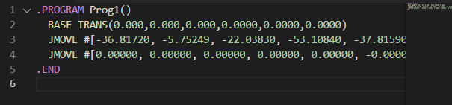

Robotic Simulators
Move from: [$θ_{1}$, $θ_{2},…,θ_{6}$] = [0,0,0,0,0,0]
To: [$θ_{1}$, $θ_{2},…,θ_{6}$] = [-36.81, -5.75, -22.03, -53.10, -37.81, 69.74]
Kawasaki Robotics:

Slide 13
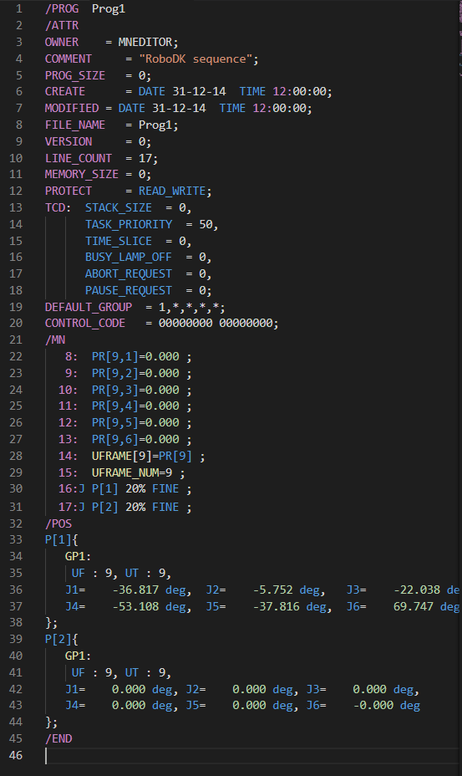

Robotic Simulators
Move from: [$θ_{1}$, $θ_{2},…,θ_{6}$] = [0,0,0,0,0,0]
To: [$θ_{1}$, $θ_{2},…,θ_{6}$] = [-36.81, -5.75, -22.03, -53.10, -37.81, 69.74]
FANUC:

Slide 14
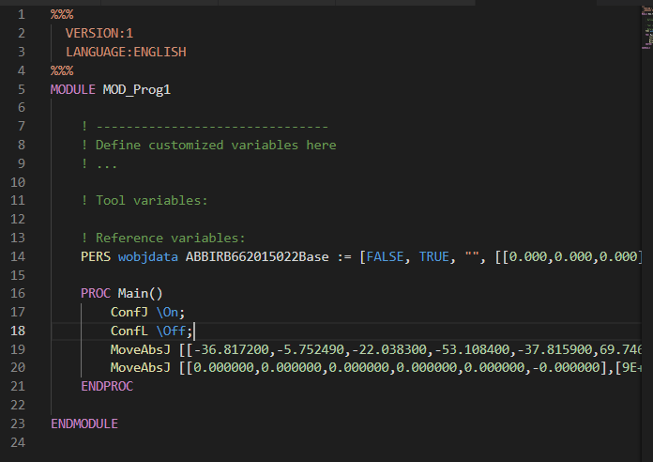

Robotic Simulators
Move from: [$θ_{1}$, $θ_{2},…,θ_{6}$] = [0,0,0,0,0,0]
To: [$θ_{1}$, $θ_{2},…,θ_{6}$] = [-36.81, -5.75, -22.03, -53.10, -37.81, 69.74]
ABB:

Slide 15
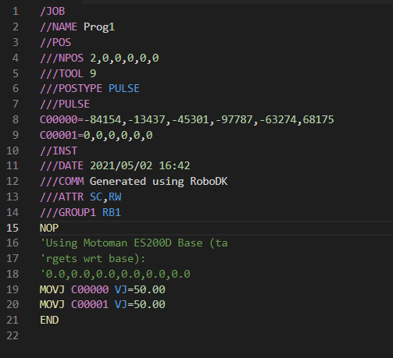

Robotic Simulators
Move from: [$θ_{1}$, $θ_{2},…,θ_{6}$] = [0,0,0,0,0,0]
To: [$θ_{1}$, $θ_{2},…,θ_{6}$] = [-36.81, -5.75, -22.03, -53.10, -37.81, 69.74]
Motoman:

Slide 16
Unified Robot Simulator: RoboDK
Has basic functionality of robot simulator
“Translates” programs to each brand’s programming language
Allows the user to easily change robots, or work with multiple brands

Slide 17
Unified Robot Simulator: RoboDK
Won’t have full functionality of native software
Imperfect integration with controller
Not supported by brand
Limited advanced options

